Slide 1


CISC450 Computer Networks
Lesson 11
Internetworking
Slides courtesy of
Wm. Stallings

Slide 2
Internetworking Terms (1)
Communications Network
  Facility that provides data transfer service
An internet
  Collection of communications networks interconnected by bridges and/or routers
The Internet - note upper case I
  The global collection of thousands of individual machines and networks
Intranet
  Corporate internet operating within the organization
  Uses Internet (TCP/IP and http)technology to deliver documents and resources

Slide 3
Internetworking Terms (2)
End System (ES)
  Device attached to one of the networks of an internet
  Supports end-user applications or services
Intermediate System (IS)
  Device used to connect two networks
  Permits communication between end systems attached to different networks

Slide 4
Internetworking Terms (3)
Bridge
  IS used to connect two LANs using similar LAN protocols
  Address filter passing on packets to the required network only
  OSI layer 2 (Data Link)
Router
  Connects two (possibly dissimilar) networks
  Uses internet protocol present in each router and end system
  OSI Layer 3 (Network)

Slide 5
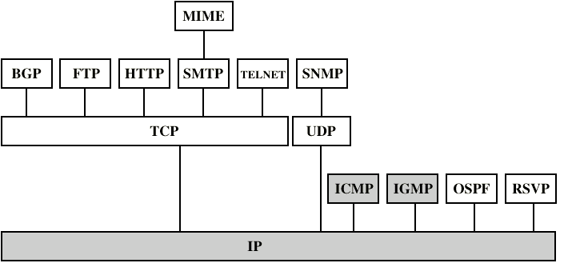
Internetworking Protocols

Slide 6
Requirements of Internetworking
Link between networks
  Minimum physical and link layer
Routing and delivery of data between processes on different networks
Accounting services and status info
Independent of network architectures

Slide 7
Network Architecture Features
Addressing
Packet size
Access mechanism
Timeouts
Error recovery
Status reporting
Routing
User access control
Connection based or connectionless

Slide 8
Architectural Approaches
Connection oriented
Connectionless

Slide 9
Connection Oriented
Assume that each network is connection oriented
IS connect two or more networks
  IS appear as DTE to each network
  Logical connection set up between DTEs
    Concatenation of logical connections across networks
  Individual network virtual circuits joined by IS
May require enhancement of local network services
  802, FDDI are datagram services

Slide 10
Connection Oriented IS Functions
Relaying
Routing
e.g. X.75 used to interconnect X.25 packet switched networks
Connection oriented not often used
  (IP dominant)

Slide 11
Connectionless Operation
Corresponds to datagram mechanism in packet switched network
Each NPDU treated separately
Network layer protocol common to all DTEs and routers
  Known generically as the internet protocol
Internet Protocol
  One such internet protocol developed for ARPANET
  RFC 791 (Get it and study it)
Lower layer protocol needed to access particular network

Slide 12
Connectionless Internetworking
Advantages
  Flexibility
  Robust
  No unnecessary overhead
Unreliable
  Not guaranteed delivery
  Not guaranteed order of delivery
    Packets can take different routes
  Reliability is responsibility of next layer up (e.g. TCP)

Slide 13
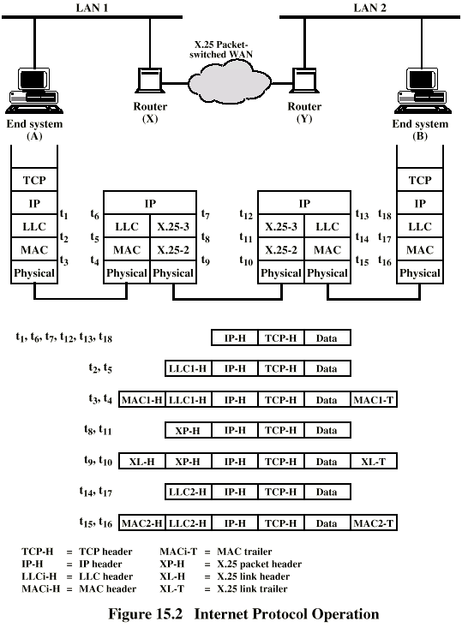
IP Operation

Slide 14
Design Issues
Routing
Datagram lifetime
Fragmentation and re-assembly
Error control
Flow control

Slide 15
Routing
End systems and routers maintain routing tables
  Indicate next router to which datagram should be sent
  Static
    May contain alternative routes
  Dynamic
    Flexible response to congestion and errors
Source routing
  Source specifies route as sequential list of routers to be followed
  Security
  Priority
Route recording

Slide 16
Datagram Lifetime
Datagrams could loop indefinitely
  Consumes resources
  Transport protocol may need upper bound on datagram life
Datagram marked with lifetime
  Time To Live field in IP
  Once lifetime expires, datagram discarded (not forwarded)
  Hop count
    Decrement time to live on passing through a each router
  Time count
    Need to know how long since last router

Slide 17
Fragmentation and
Re-assembly
Different packet sizes
When to re-assemble
  At destination
    Results in packets getting smaller as data traverses internet
  Intermediate re-assembly
    Need large buffers at routers
    Buffers may fill with fragments
    All fragments must go through same router
      Inhibits dynamic routing

Slide 18
IP Fragmentation (1)
IP re-assembles at destination only
Uses fields in header
  Data Unit Identifier (ID)
    Identifies end system originated datagram
      Source and destination address
      Protocol layer generating data (e.g. TCP)
      Identification supplied by that layer
  Data length
    Length of user data in octets

Slide 19
IP Fragmentation (2)
  Offset
    Position of fragment of user data in original datagram
    In multiples of 64 bits (8 octets)
  More flag
    Indicates that this is not the last fragment

Slide 20
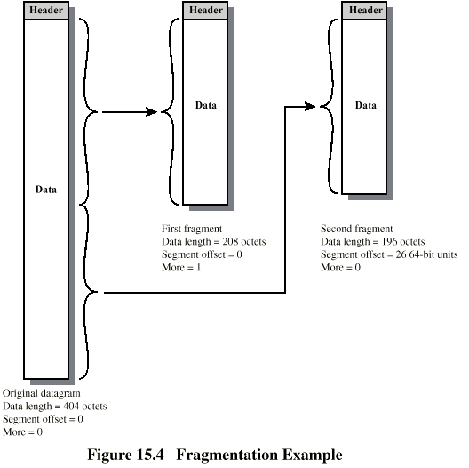
Fragmentation Example

Slide 21
Dealing with Failure
Re-assembly may fail if some fragments get lost
  (What is the impact if you send REALLY long messages with sporadic bit errors occurring?)
Need to detect failure
Re-assembly time out
  Assigned to first fragment to arrive
  If timeout expires before all fragments arrive, discard partial data
Use packet lifetime (time to live in IP)
  If time to live runs out, kill partial data

Slide 22
Error Control
Not guaranteed delivery
Router should attempt to inform source if packet discarded
  e.g. for time to live expiring
Source may modify transmission strategy
May inform high layer protocol
Datagram identification needed

Slide 23
Flow Control
Allows routers and/or stations to limit rate of incoming data
Limited in connectionless systems
Send flow control packets
  Requesting reduced flow
e.g. ICMP

Slide 24
Internet Protocol (IP)
Part of TCP/IP
  Used by the Internet
Specifies interface with higher layer
  e.g. TCP
Specifies protocol format and mechanisms

Slide 25
IP Services
Primitives
  Functions to be performed
  Form of primitive implementation dependent
    e.g. subroutine call
  Send
    Request transmission of data unit
  Deliver
    Notify user of arrival of data unit
Parameters
  Used to pass data and control info

Slide 26
Parameters (1)
Source address
Destination address
Protocol
  Recipient e.g. TCP
Type of Service
  Specify treatment of data unit during transmission through networks
Identification
  Source, destination address and user protocol
  Uniquely identifies PDU
  Needed for re-assembly and error reporting
  Send only

Slide 27
Parameters (2)
Don’t fragment indicator
  Can IP fragment data
  If not, may not be possible to deliver
  Send only
Time to live
  Send onl
Data length
Option data
User data

Slide 28
Type of Service
Precedence
  8 levels
Reliability
  Normal or high
Delay
  Normal or low
Throughput
  Normal or high

Slide 29
Options
Security
Source routing
Route recording
Stream identification
Timestamping

Slide 30
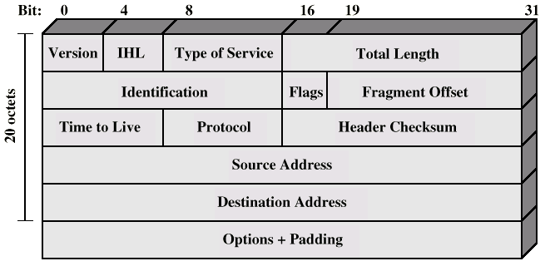
IP Protocol

Slide 31
Header Fields (1)
Version
  Currently 4
  IP v6 - see later
Internet header length
  In 32 bit words
  Including options
Type of service
Total length
  Of datagram, in octets

Slide 32
Header Fields (2)
Identification
  Sequence number
  Used with addresses and user protocol to identify datagram uniquely
Flags
  More bit
  Don’t fragment
Fragmentation offset
Time to live
Protocol
  Next higher layer to receive data field at destination

Slide 33
Header Fields (3)
Header checksum
  Reverified and recomputed at each router
  16 bit ones complement sum of all 16 bit words in header
  Set to zero during calculation
Source address
Destination address
Options
Padding
  To fill to multiple of 32 bits long

Slide 34
Data Field
Carries user data from next layer up
Integer multiple of 8 bits long (octet)
Max length of datagram (header plus data) 65,535 octets

Slide 35
IP Addresses - Class A
Warning
Of historical interest
ONLY
32 bit global internet address
Network part and host part
Class A
  Start with binary 0
  All 0 reserved
  01111111 (127) reserved for loopback
  Range 1.x.x.x to 126.x.x.x
  All allocated

Slide 36
IP Addresses - Class B
Warning
Of historical interest
ONLY
Start 10
Range 128.x.x.x to 191.x.x.x
Second Octet also included in network address
2¹⁴ = 16,384 class B addresses
All allocated

Slide 37
IP Addresses - Class C
Warning
Of historical interest
ONLY
Start 110
Range 192.x.x.x to 223.x.x.x
Second and third octet also part of network address
2²¹ = 2,097,152 addresses
Nearly all allocated
  See IPv6

Slide 38
Subnets and Subnet Masks
Allow arbitrary complexity of internetworked LANs within organization
Insulate overall internet from growth of network numbers and routing complexity
Site looks to rest of internet like single network
Each LAN assigned subnet number
Host portion of address partitioned into subnet number and host number
Local routers route within subnetted network
Subnet mask indicates which bits are subnet number and which are host number

Slide 39
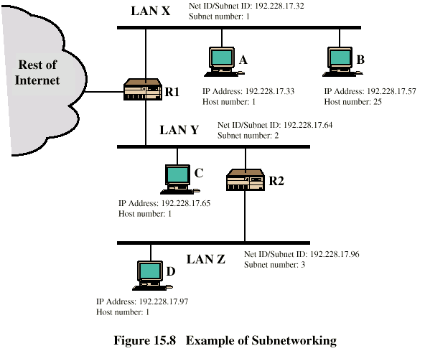
Routing Using Subnets

Slide 40
ICMP
Internet Control Message Protocol
RFC 792 (get it and study it)
Transfer of (control) messages from routers and hosts to hosts
Feedback about problems
  e.g. time to live expired
Encapsulated in IP datagram
  Not reliable
Used by PING (Packet INternet Groper)

Slide 41
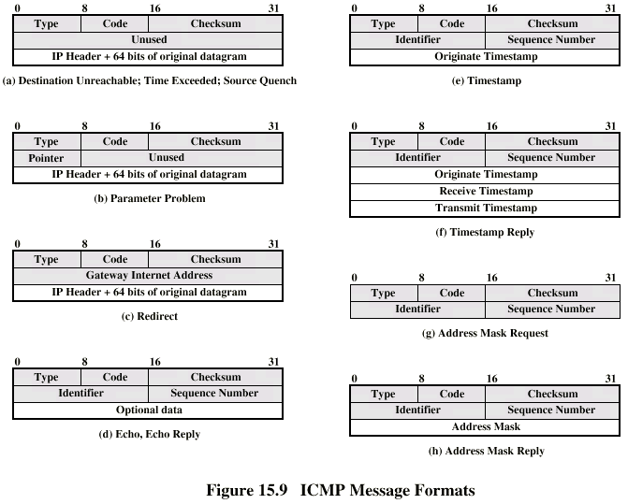
ICMP Message Formats

Slide 42
IP v6 - Version Number
IP v 1-3 defined and replaced
IP v4 - current version
IP v5 - streams protocol
IP v6 - replacement for IP v4
  During development it was called IPng
  Next Generation

Slide 43
Why Change IP?
Address space exhaustion
  Two level addressing (network and host) wastes space
  Network addresses used even if not connected to Internet
  Growth of networks and the Internet
  Extended use of TCP/IP
  Single address per host
Requirements for new types of service

Slide 44
Routing Protocols
Routing Information
  About topology and delays in the internet
Routing Algorithm
  Used to make routing decisions based on information

Slide 45
Autonomous Systems (AS)
Group of routers
Exchange information
Common routing protocol
Set of routers and networks managed by signle organization
A connected network
  There is at least one route between any pair of nodes

Slide 46
Interior Router Protocol (IRP)
Passes routing information between routers within AS
May be more than one AS in internet
Routing algorithms and tables may differ between different AS
Routers need some info about networks outside their AS
Used exterior router protocol (ERP)
IRP needs detailed model
ERP supports summary information on reachability

Slide 47
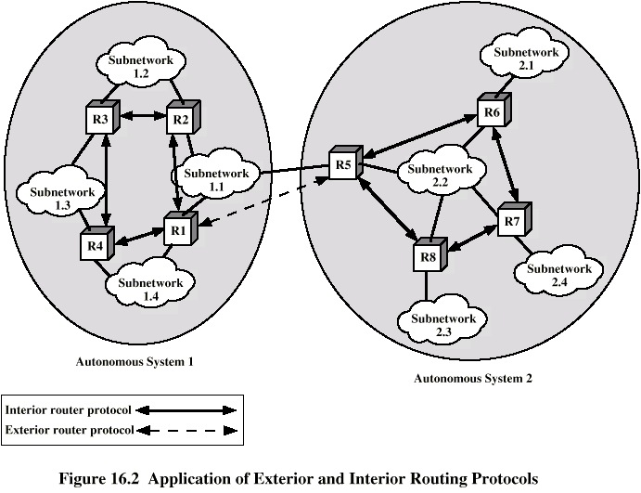
Application of IRP and ERP

Slide 48
IGP’s—RIP
Distance vector
Split horizon
Decisions based on hop count
Notes:
RFC 1058 - Routing Information Protocol (v1)
RFC 1723 - Routing Information Protocol (v2)
RFC 1724 - RIP v2 MIB extensions
RFC 1817 - CIDR and Classful Routing
RFC 1923 - RIPv1 Applicability Statement for Historical Status
draft-ietf-ripv2-md5-02 - MD5 authentication extensions for RIPv2

Slide 49
IGP’s—RIP (Cont.)
-
+
16 hop maximum
30 second
periodic update
Bandwidth inefficient
No VLSM
Slow convergence
No security
No multicast
But it is a ‘standard’
Simple
CPU efficient
Handles silent hosts (routed)
Supports default injection
Notes:
Other RIP Limitations (from RFC 1923):
1) RIPv1 can not be used with variable length subnetting. In the presence of variable length subnetting it will consistently misinterpret prefix lengths.
2) RIPv1 is difficult to use with supernetting. All CIDR supernets must be exploded and advertised to RIPv1 as individual "natural" classful advertisements.
3) Even when the networks running RIPv1 are themselves only subnetted in fixed ways, if the remainder of the network has variable subnetting then one must carefully make sure that RIPv1 does not destroy the mask information when it passes through those subnets running RIPv1. Put another way, co-existence with mutual information exchange between RIPv1 and more advanced routing protocols is problematic at best. Note that this applies even when the other routing protocol is RIPv2.
4) The Internet will soon be making use of addresses which appear to RIPv1 to be parts of Class A networks. Networks using RIPv1 may not be able to reach all sites assigned the subsections of a single A.

Slide 50



IGP Testbed
Target
Worst Case
Link Failure
Branch example
Point-to-point subinterfaces
620 routes
T-1 uplinks
64 Kb downlinks
Frame
123 Remote Sites
2 PVC’s Each
Notes:
This is an example test environment that is reasonable for all IGP’s being reviewed. The purpose is simply to draw comparisons in a fixed environment.
Each remote has one circuit with two PVC’s.
The PVC’s are mapped to both core routers.
Any conclusions extrapolated to other topologies need to be well thought out.

Slide 51
IGP Testbed—RIP Results
512 byte packets
25 packets per interval
3.2 seconds per remote per interval
10.67% overhead per update period
12.5 mb per interval for each core router
  123 remotes on NBMA
Convergence at 3–6 minutes
Notes:
Packets per interval per remote = (#routes-4)/25 + 1
= 616/25 +1
= 25
Bits for transmission = 512bytes per packet * 8 * 25
= 102,400 bits
Remote time = Bits/transmission speed
= 102,400/64,000
= 1.6 Seconds per PVC
Overhead = (2*Remote Time)/periodic update
= 3.2/30
= 10.66%
Core Time = (bits * 123)/ transmission speed
= (102K*123)/1,540,000
= 12,595,200/1,540,000
= 8.17 Seconds
Convergence is measured by disconnecting a core ethernet link, a T1, an access circuit and a specific PVC.

Slide 52
IGP’s—RIP Conclusions
Antiquated
Significant overhead
Will not scale
Notes:
RFC 1923 was created to specifically recommend that RIP be obsoleted.

Slide 53
IGP’s—RIPv2
Distance vector
Decisions based on hop count
Adds VLSM support
Notes:
RFC 1058 - Routing Information Protocol (v1)
RFC 1723 - Routing Information Protocol (v2)
RFC 1724 - RIP v2 MIB extensions
RFC 1817 - CIDR and Classful Routing
RFC 1923 - RIPv1 Applicability Statement for Historical Status
draft-ietf-ripv2-md5-02 - MD5 authentication extensions for RIPv2

Slide 54
IGP’s—RIPv2 (Cont.)
-
+
Standards based
Simple
CPU efficient
Handles silent
hosts (routed)
Supports default injection
Authentication
Multicast
16 hop maximum
30 second
periodic update
Bandwidth inefficient
Slow convergence
Notes:
Other RIP Limitations (from RFC 1923):
1) RIPv1 can not be used with variable length subnetting. In the presence of variable length subnetting it will consistently misinterpret prefix lengths.
2) RIPv1 is difficult to use with supernetting. All CIDR supernets must be exploded and advertised to RIPv1 as individual "natural" classful advertisements.
3) Even when the networks running RIPv1 are themselves only subnetted in fixed ways, if the remainder of the network has variable subnetting then one must carefully make sure that RIPv1 does not destroy the mask information when it passes through those subnets running RIPv1. Put another way, co-existence with mutual information exchange between RIPv1 and more advanced routing protocols is problematic at best. Note that this applies even when the other routing protocol is RIPv2.
4) The Internet will soon be making use of addresses which appear to RIPv1 to be parts of Class A networks. Networks using RIPv1 may not be able to reach all sites assigned the subsections of a single A.

Slide 55
IGP Testbed
Target
Worst Case
Link Failure
Branch example
Point-to-point subinterfaces
620 routes
T-1 uplinks
64 Kb downlinks
Frame
123 Remote Sites
2 PVC’s Each
Notes:
This is an example test environment that is reasonable for all IGP’s being reviewed. The purpose is simply to draw comparisons in a fixed environment.
Each remote has one circuit with two PVC’s.
The PVC’s are mapped to both core routers.
Any conclusions extrapolated to other topologies need to be well thought out.

Slide 56
IGP Testbed—RIPv2 Results
512 byte packets
25 packets per interval
3.2 seconds per remote per interval
10.67% overhead per update period
12.5 mb per interval for each core router
  123 remotes on NBMA
Convergence at 3–6 minutes
Notes:
Packets per interval per remote = (#routes-4)/25 + 1
= 616/25 +1
= 25
Bits for transmission = 512bytes per packet * 8 * 25
= 102,400 bits
Remote time = Bits/transmission speed
= 102,400/64,000
= 1.6 Seconds per PVC
Overhead = (2*Remote Time)/periodic update
= 3.2/30
= 10.66%
Core Time = (bits * 123)/ transmission speed
= (102K*123)/1,540,000
= 12,595,200/1,540,000
= 8.17 Seconds
Convergence is measured by disconnecting a core ethernet link, a T1, an access circuit and a specific PVC.

Slide 57
Open Shortest Path First (1)
OSPF
IGP of Internet
Replaced Routing Information Protocol (RIP)
Uses Link State Routing Algorithm
  Each router keeps list of state of local links to network
  Transmits update state info
  Little traffic as messages are small and not sent often
  RFC 2328
Route computed on least cost based on user cost metric

Slide 58
Open Shortest Path First (2)
Topology stored as directed graph
Vertices or nodes
  Router
  Network
    Transit
    Stub
Edges
  Graph edge
    Connect two router
    Connect router to network

Slide 59
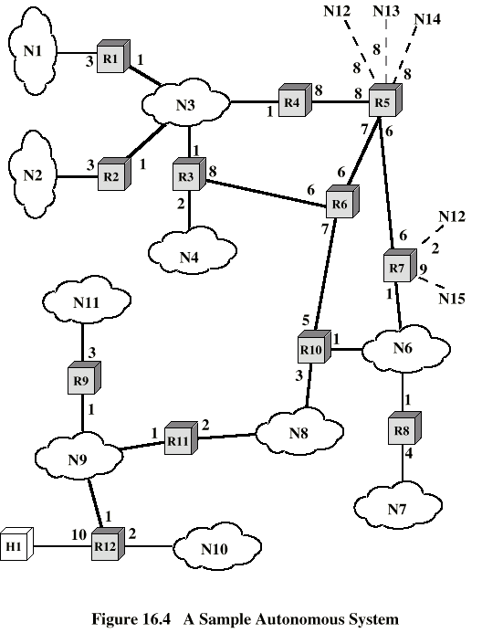
Sample AS

Slide 60
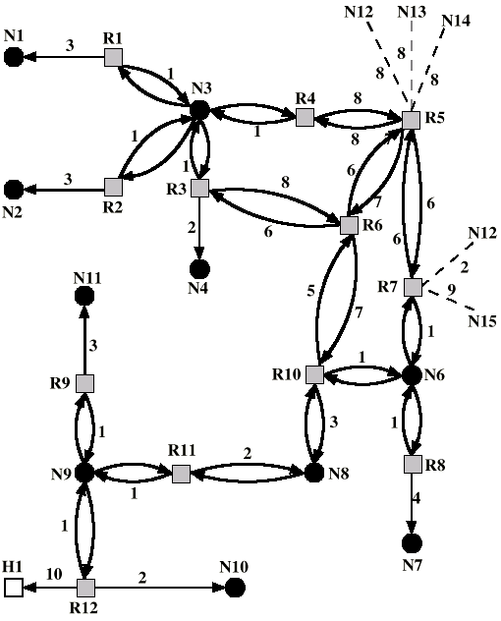
Directed
Graph of AS

Slide 61
Operation
Dijkstra’s algorithm (Appendix 10A) used to find least cost path to all other networks
Next hop used in routing packets

Slide 62
IGP’s—OSPF
Link state
Decisions based on cost
Cost based on bandwidth
  (Default cisco cost =100,000/bandwidth k)
Adds VLSM support
Supports non-contiguous networks
Classless
Notes:
RFC 2178 OSPF Version 2 (supercedes RFC 1583).
RFC 2154 OSPF with Digital Signatures.
RFC 1850 OSPF Version 2 Management Information Base.
RFC 1793 Extending OSPF to Support Demand Circuits.
IETF acts a change board for the evolving OSPF environment.
The Cisco OSPF Design Guide is on CCO at: http://www.cisco.com/warp/public/104/1.html
OSPF is also discussed in Routing In The Internet by Christian Huitema. Prentice Hall PTR, Englewood Cliffs, NJ 07632.Copyright 1995.

Slide 63
IGP’s—OSPF (Cont.)
-
+
CPU intensive
30 minute periodic update
Limited to a 2
layer hierarchy
LSA flooding
Databases must
be in synch
Requires detailed planning
No auto summarization
Standards based
Fast convergence
Bandwidth efficient
Supports default injection
Authentication
Router ID
Hello’s
Stub areas
Notes:
Dijkstra is run every time a link-state change occurs.
The database is refreshed every 30 minutes by RFC.
Every area must touch area 0, no additional hierarchy is supported. The workaround is virtual links, but these are not advised for anything other than migration.
LSA’s are flooded to all routers within an area.
Databases must be synchronized within an area, this is not impacted by distribution lists (they ONLY impact the routing table).
The only impact on the database from distribution lists is with a outbound list on an ASBURY. This limits the external routes inserted into the OSPF database.
Address summarization is required for large scale deployments.

Slide 64
IGP Testbed
Target
Worst Case
Link Failure
Branch example
Point-to-point subinterfaces
620 routes
T-1 uplinks
64 Kb downlinks
Frame
123 Remote Sites
2 PVC’s Each
Notes:
This is an example test environment that is reasonable for all IGP’s being reviewed. The purpose is simply to draw comparisons in a fixed environment.
Each remote has one circuit with two PVC’s.
The PVC’s are mapped to both core routers.
Any conclusions extrapolated to other topologies need to be well thought out.

Slide 65
IGP Testbed—OSPF Results
1 LSA per packet (externals)
Multiple LSA’s per packet (internal)
CPU overhead at 100%
  (Duration depends on topology and routing table change)
Convergence at < 20 seconds
  (In the given example)
Notes:
Convergence is measured by disconnecting a core ethernet link, a T1, an access circuit and a specific PVC.

Slide 66
IGP’s—OSPF Conclusions
Fast convergence
Significant CPU overhead
Can scale to thousands of nets
  (Requires strict hierarchical structure
  and address summarization)

Slide 67
IGP’s—EIGRP
Modified distance vector
Decisions based on bandwidth
and delay
Adds VLSM support
Supports non-contiguous networks
Classless
Notes:
EIGRP is described in the Cisco IOS Manual set.
Also in Routing In The Internet by Christian Huitema. Prentice Hall PTR, Englewood Cliffs, NJ 07632.Copyright 1995.

Slide 68
IGP’s—EIGRP (Cont.)
-
+
Fast convergence
No periodic update
Supports default injection
Authentication
Hello’s
Auto summarization
Simple to implement
Bandwidth intensive
Not efficient in highly redundant topologies
Proprietary
Queries used to find
new routes
Topology tables can
be large
Advertizes its
routing table
Notes:
DUAL is run every time a routing change occurs.
Address summarization is required for large scale deployments.

Slide 69
IGP Testbed
Target
Worst Case
Link Failure
Branch example
Point-to-point subinterfaces
620 routes
T-1 uplinks
64 Kb downlinks
Frame
123 Remote Sites
2 PVC’s Each
Notes:
This is an example test environment that is reasonable for all IGP’s being reviewed. The purpose is simply to draw comparisons in a fixed environment.
Each remote has one circuit with two PVC’s.
The PVC’s are mapped to both core routers.
Any conclusions extrapolated to other topologies need to be well thought out.

Slide 70
IGP Testbed—EIGRP Results
Can use full MTU packets
with updates
CPU overhead at 100%
  (Duration depends on topology and routing table change)
Convergence at < 10 seconds
  (In the given example)
Notes:
Convergence is measured by disconnecting a core ethernet link, a T1, an access circuit and a specific PVC.

Slide 71
IGP’s—EIGRP Conclusions
Fast convergence
Works on meshed networks
Can scale to thousands of nets
  (Requires strict hierarchical structure
  and summarization)

Slide 72
IGP Conclusions
Use EIGRP or OSPF as an IGP
New designs with strict hierarchy could use either protocol
Meshed designs and legacy networks work better with EIGRP
Highly redundant topologies with hierarchy work well with OSPF

Slide 73
Border Gateway Protocol (BGP)
For use with TCP/IP internets
Preferred EGP of the Internet
Messages sent over TCP connections
  Open
  Update
  Keep alive
  Notification
Procedures
  Neighbor acquisition
  Neighbor reachability
  Network reachability

Slide 74
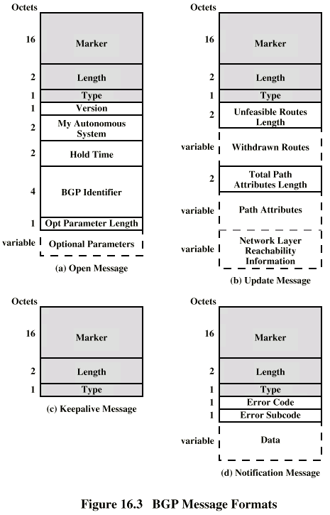
BGP Messages

Slide 75
BGP Procedure
Open TCP connection
Send Open message
  Includes proposed hold time
Receiver selects minimum of its hold time and that sent
  Max time between Keep alive and/or update messages

Slide 76
Message Types
Keep Alive
  To tell other routers that this router is still here
Update
  Info about single routes through internet
  List of routes being withdrawn
  Includes path info
    Origin (IGP or EGP)
    AS_Path (list of AS traversed)
    Next_hop (IP address of boarder router)
    Multi_Exit_Disc (Info about routers internal to AS)
    Local_pref (Inform other routers within AS)
    Atomic_Aggregate, Aggregator (Uses address tree structure to reduce amount of info needed)

Slide 77
Uses of AS_Path and Next_Hop
AS_Path
  Enables routing policy
    Avoid a particular AS
    Security
    Performance
    Quality
    Number of AS crossed
Next_Hop
  Only a few routers implement BGP
    Responsible for informing outside routers of routes to other networks in AS

Slide 78
Notification Message
Message header error
  Authentication and syntax
Open message error
  Syntax and option not recognized
  Unacceptable hold time
Update message error
  Syntax and validity errors
Hold time expired
  Connection is closed
Finite state machine error
Cease
  Used to close a connection when there is no error

Slide 79
BGP Routing Information Exchange
Within AS, router builds topology picture using IGP
Router issues Update message to other routers outside AS using BGP
These routers exchange info with other routers in other AS
Routers must then decide best routes

